Slide 1
Name Title & Artist
Game 0008
Makes Me Wonder - Maroon 5
Low – Cracker
Shoop – Sat N Pepa
Forget You – Cee Lo Green
Rainy Day Women #12 & 35 – Bob Dylan
Say Say Say – Paul McCartney & Michael Jackson
Jealous – Nick Jonas
West End Girls – Pet Shop Boys
Pumped Up Kicks – Foster the People
Canned Heat - Jamiroquai

Slide 2
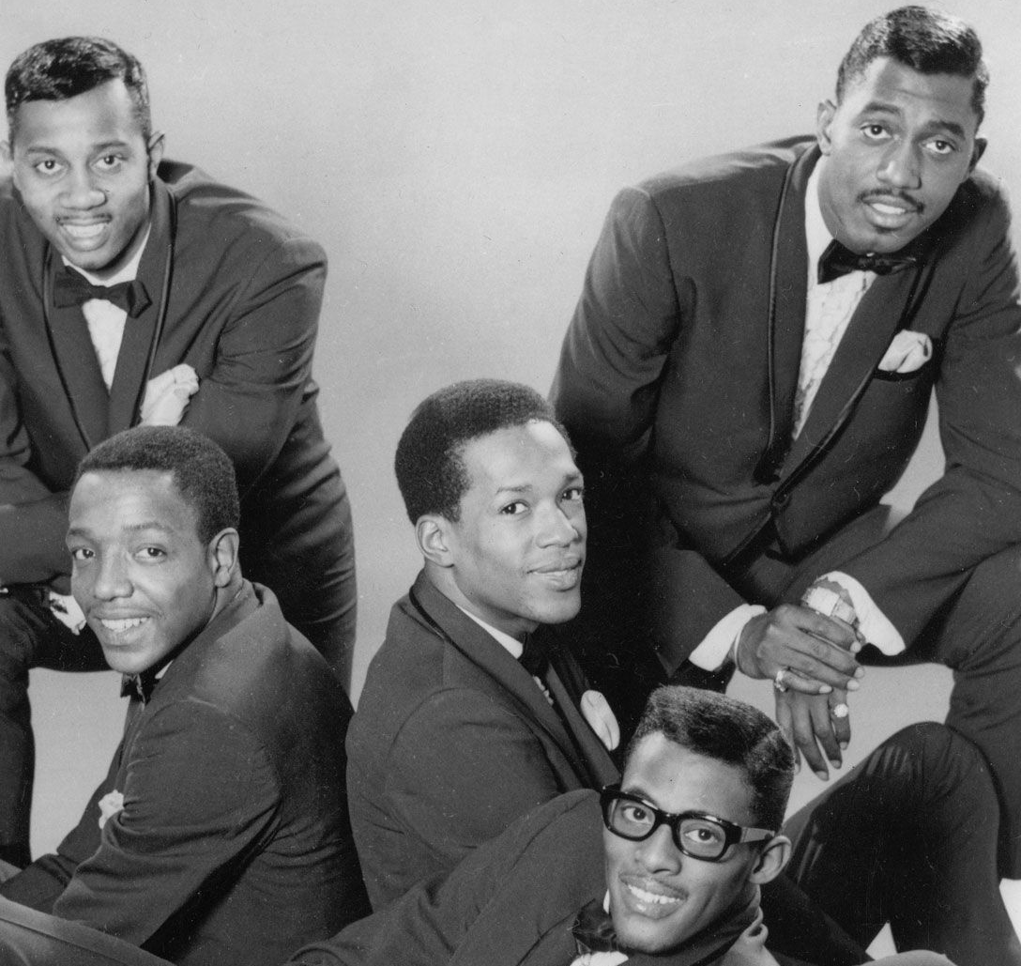
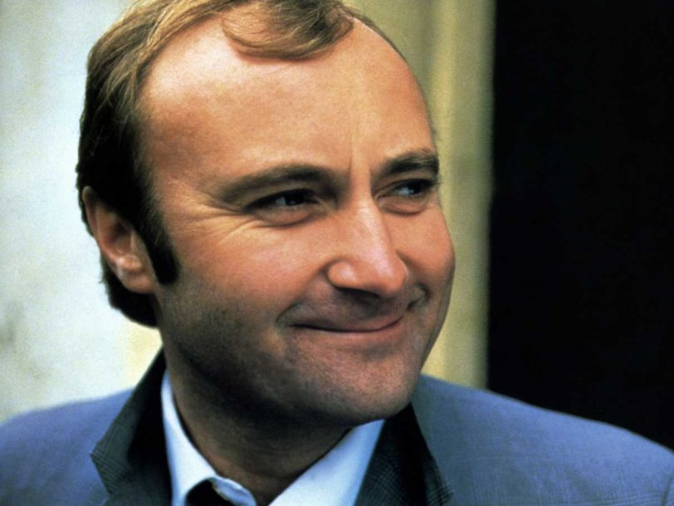
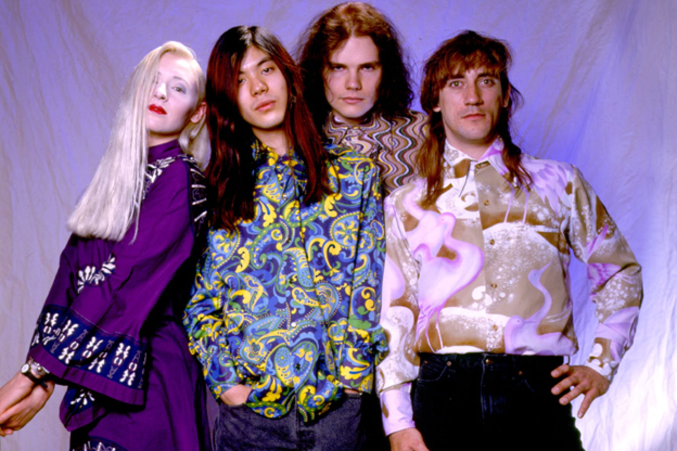
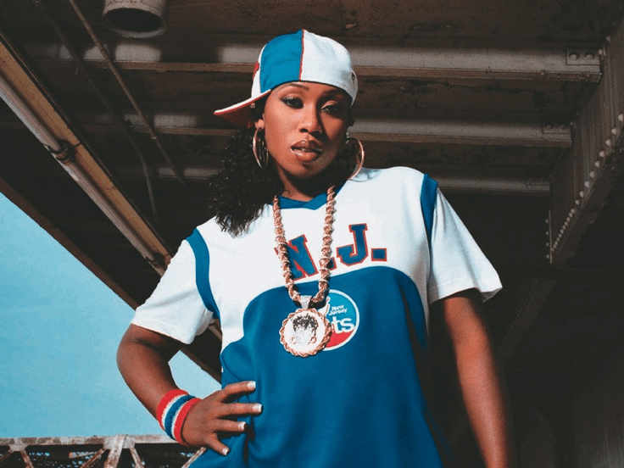
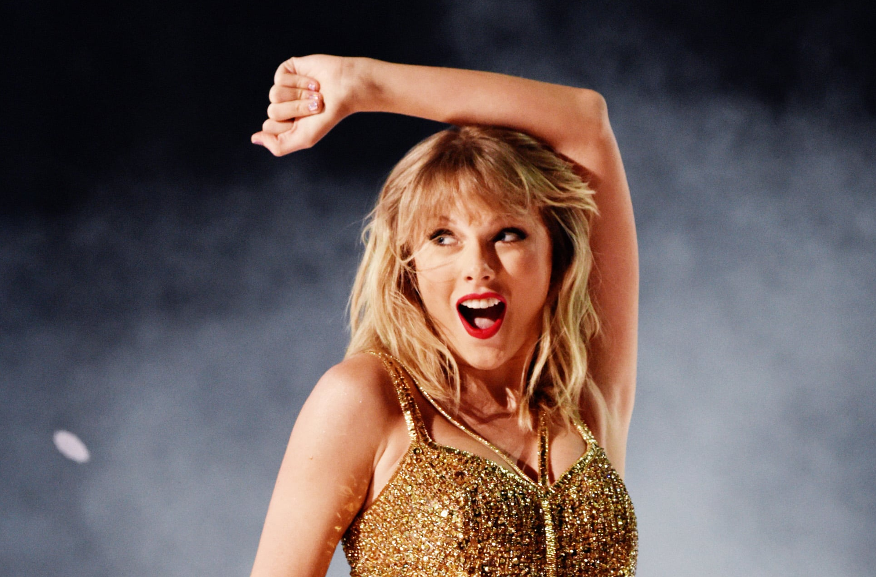
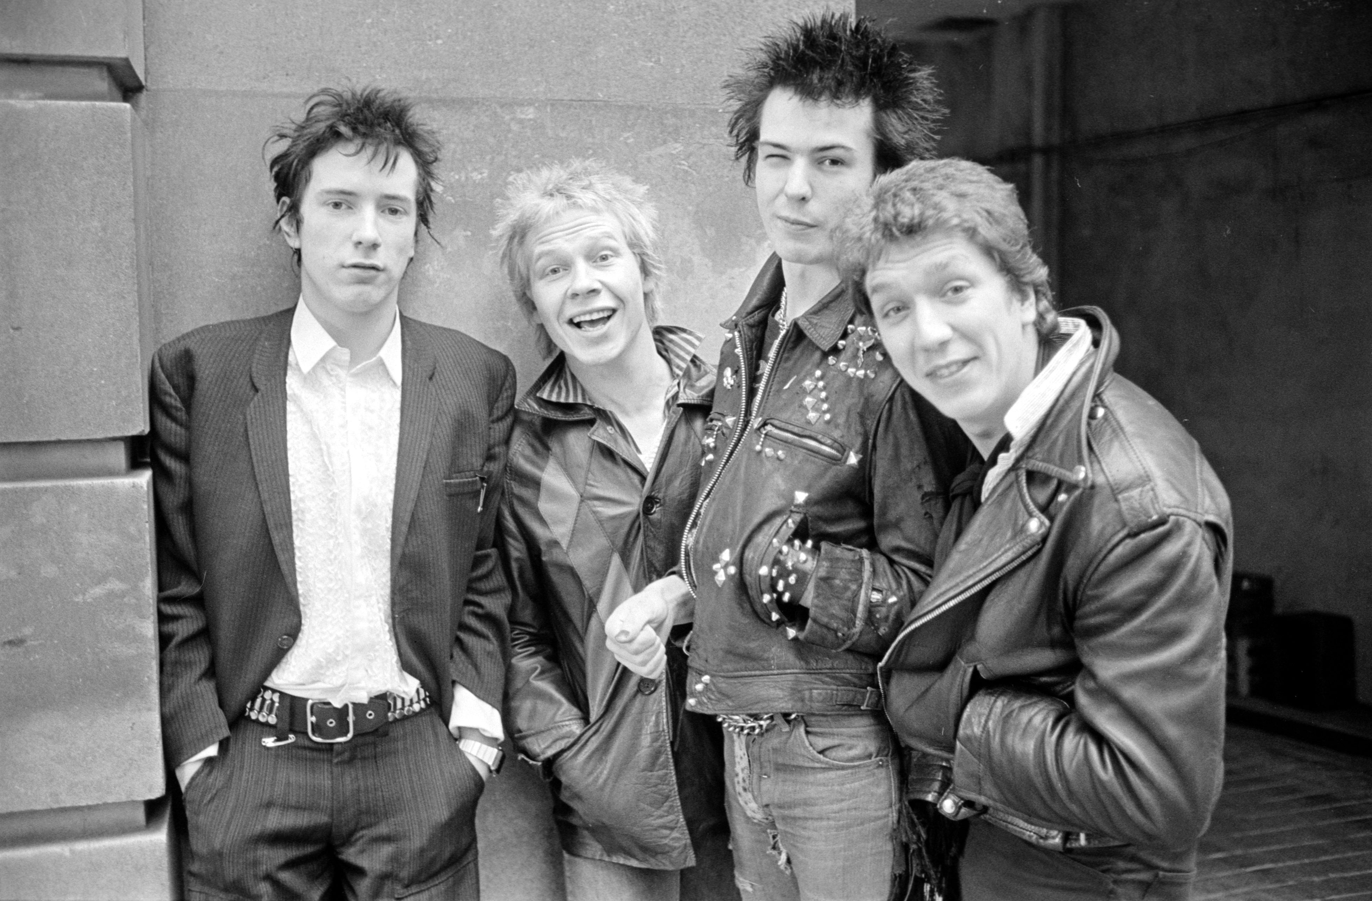
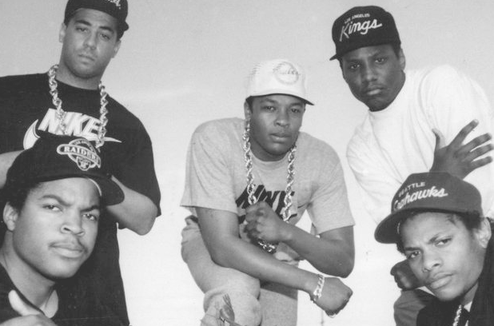
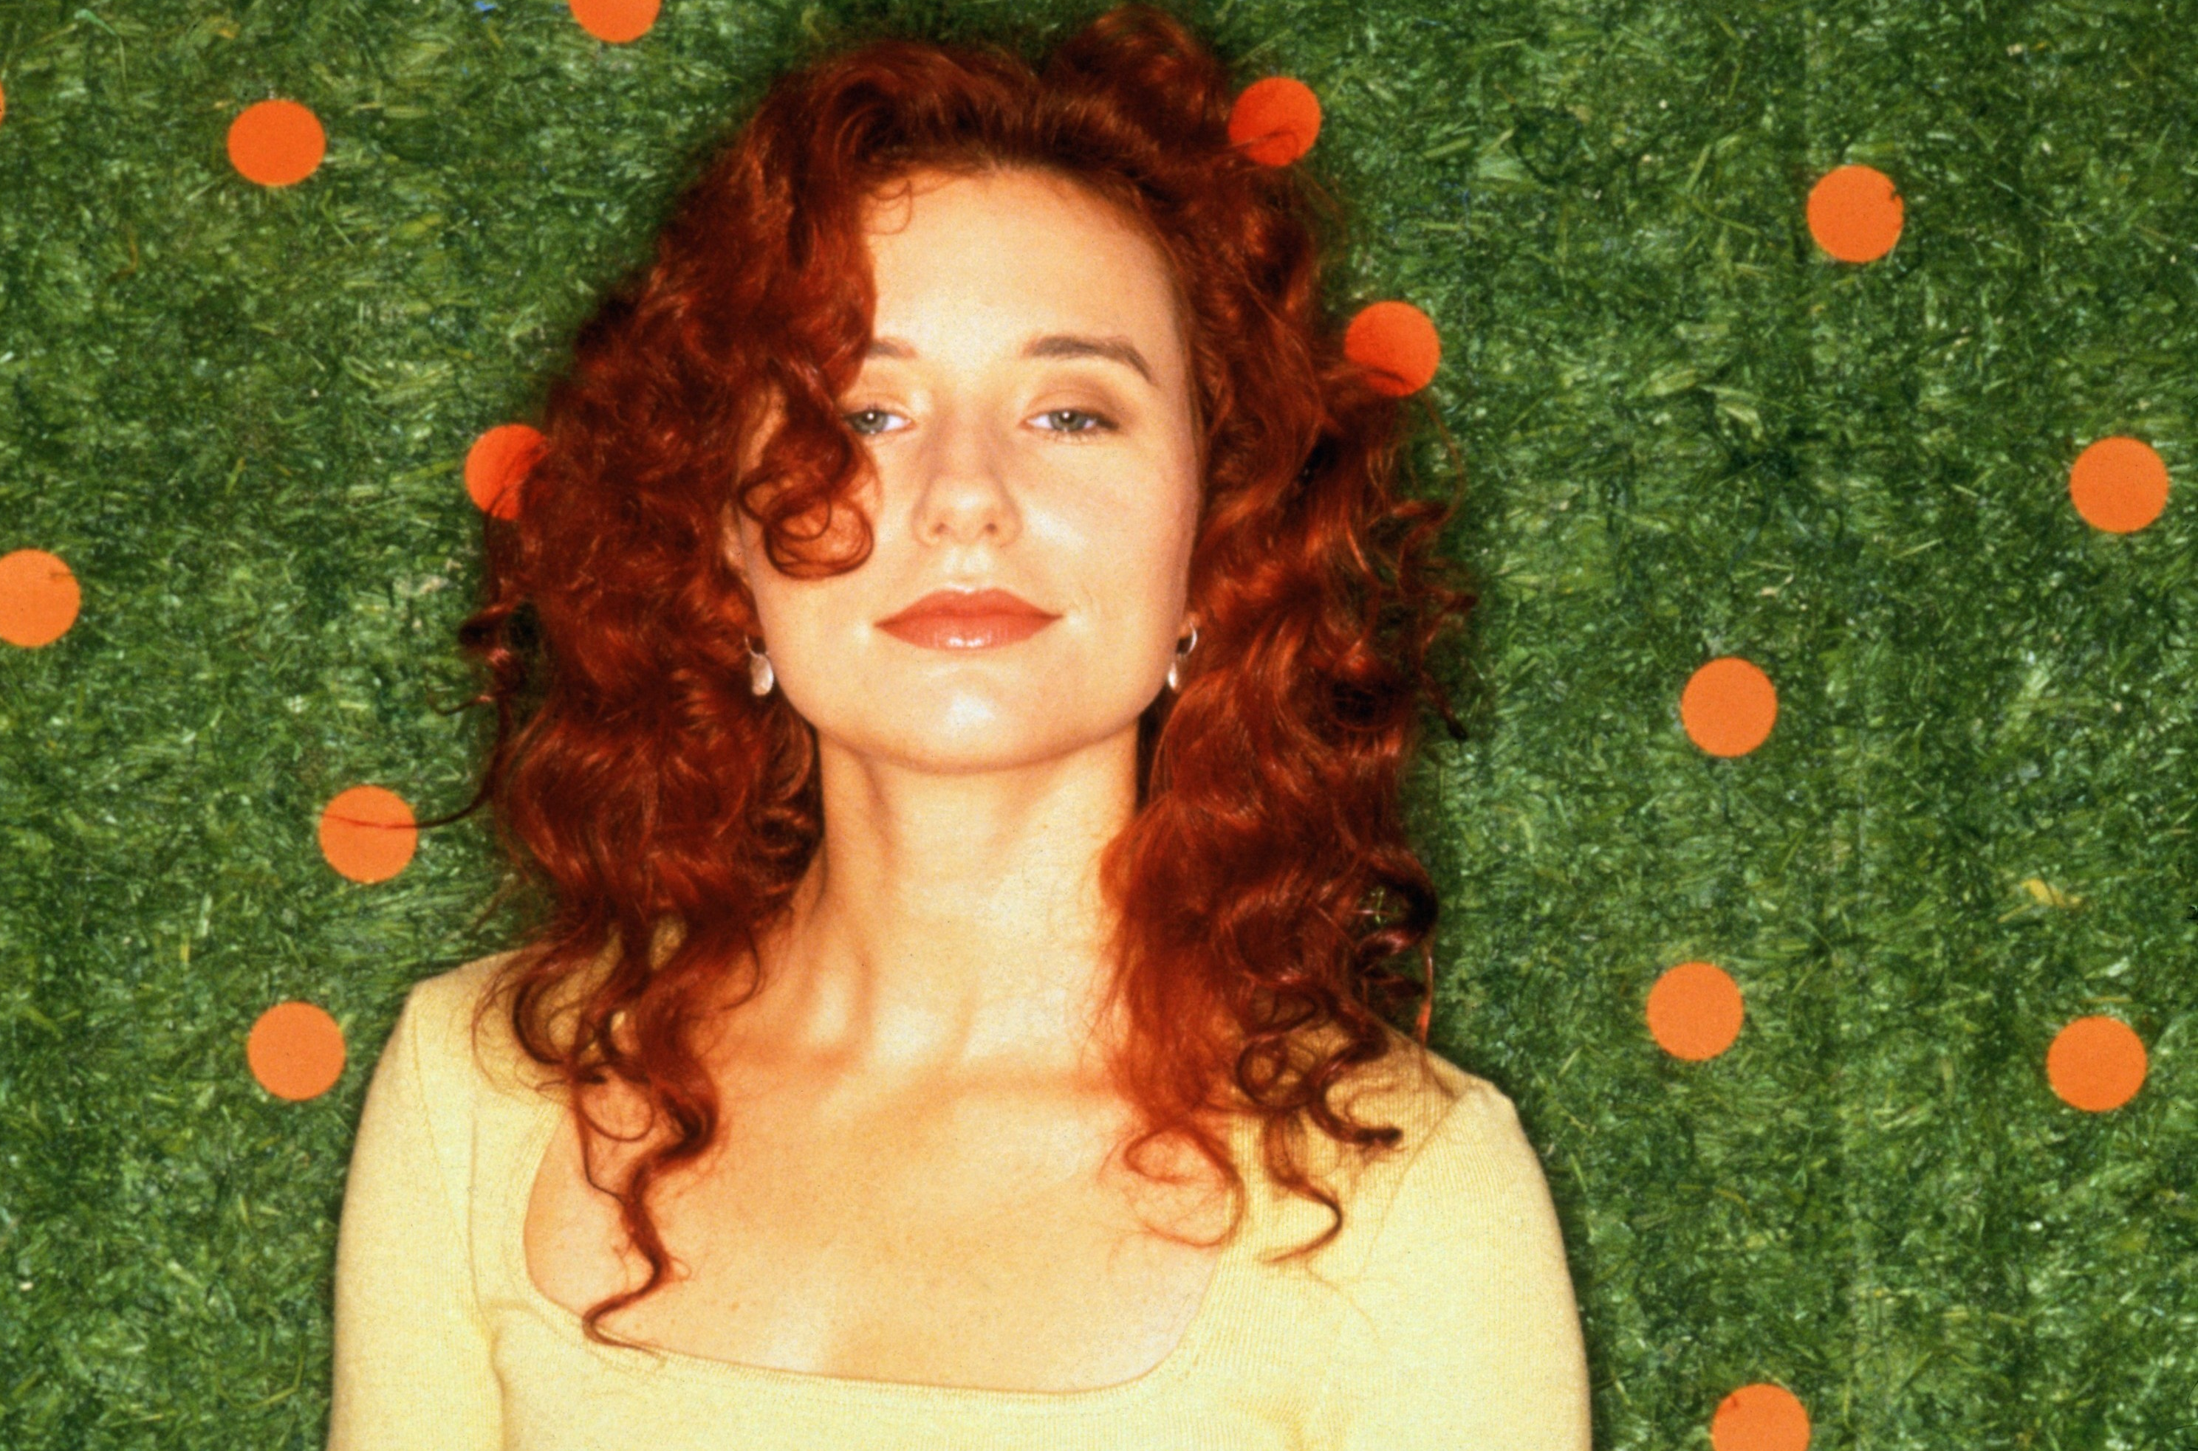
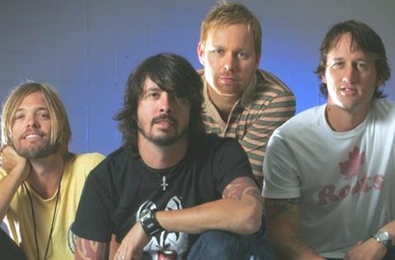
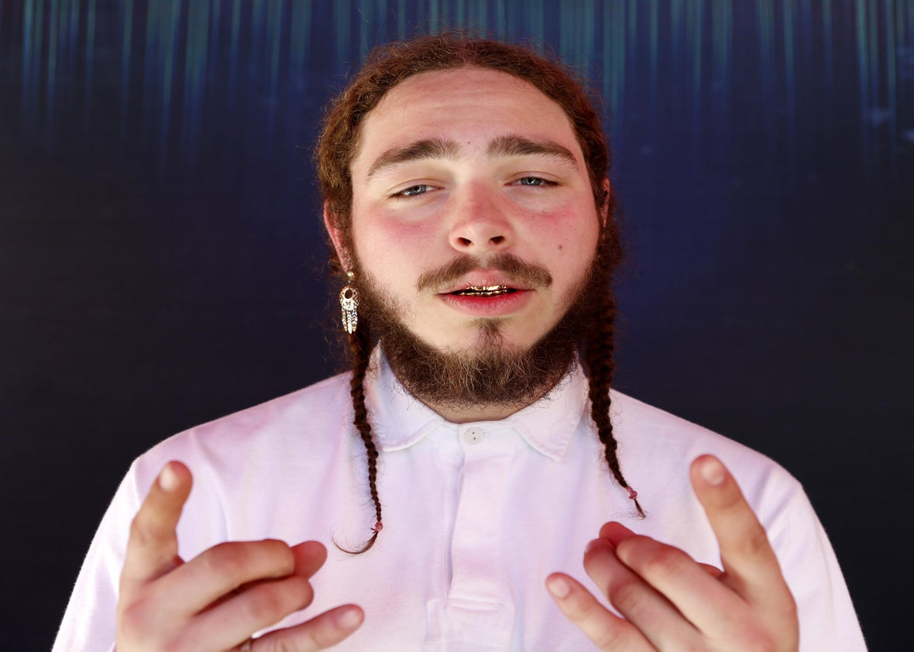
Picture Round
Instructions: Identify the artist or group on the line under each image

Slide 3
Decades In what decade was this version of the song originally released?
Roll to Me – Del Amitri – 1995
My House – Flo Rida - 2016
One Week – Barenaked Ladies - 1998
Trap Queen – Fetty Wap - 2015
Filthy – Justin Timberlake - 2018
Hard to Handle – Black Crowes - 1990
Hold Me – Fleetwood Mac - 1982
Louie Louie – The Kingsmen - 1963
E-Pro – Beck – 2005
Big Shot – Billy Joel - 1978

Slide 4
General Knowledge
In what 1969 song does David Bowie first introduce us to Major Tom? Space Oddity
According to his 1987 hit song, all of George Straits’ ex’s live in Texas and that’s why he “hangs his hat in…(what state)”? Tennessee
British pop band Right Said Fred got the idea for what 1991 song while running in a London gym surrounded by what they described as “narcissism and posing”? I’m Too Sexy
What English band, plagued by internal battles and legal issues broke up in 2009 when the guitarist posted on the band’s website about his lead vocalist brother, “…I simply could not go on working with Liam a day longer”? Oasis (Noel Gallagher said of Liam Gallagher)
David Guetta and Bebe Rexha’s 2022 hit I’m Good features an interpolation of the 1998 smash single Blue (Da Ba Dee) - a song by what Italian Eurodance group? Eiffel 65
In a classic scene from the 1937 Marx Brothers comedy film A Day at the Races, Harpo Marx plays a piano so violently that it breaks apart. What instrument does he then exhume from the wreckage and proceed to play beautifully? A harp
Which Queen album was named after a 1935 Marx Brothers comedy film? A Night at the Opera
According to wikipedia in 2023, what 3-member ensemble, formed in 1990, is the best-selling girl group since The Supremes, with 65 million records sold worldwide? TLC
In 2004 Star Search’s reigning Grand Champion Jake Simpson performed the song Isn’t She Lovely on The Oprah Winfrey Show. While he was singing – Oprah had arranged for the curtain behind him to open and reveal what harmonica playing artist? Stevie Wonder
Nate Ruess, who featured in Pink’s 2013 release Just Give Me A Reason was the lead singer of what band? Fun
One of the most popular ballets of all time, Tchaikovsky’s Swan Lake was commissioned and completed over the course of about 1 year. In what year did he complete the work? 1876

Slide 6
The Temptations
Phil Collins
The Smashing Pumpkins
Missy Elliott
Taylor Swift
Sex Pistols
N.W.A.
Tori Amos
Foo Fighters
Post Malone

